Slide 1
Traditional Methods
Jaccard Similarity
W-Shingling
Levenshtein

Slide 2
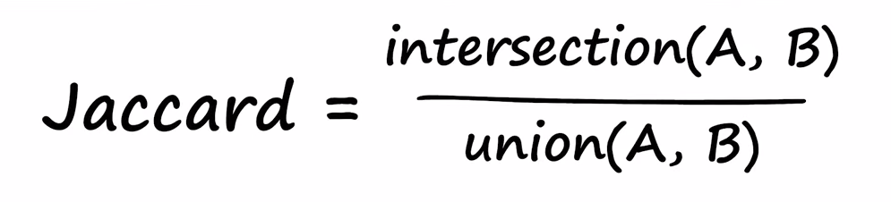
Jaccard Similarity

Slide 3
W-Shingling
Breaks down the documents into sequence of consecutive words (Shingles)
Compute Jaccard similarity score

Slide 4
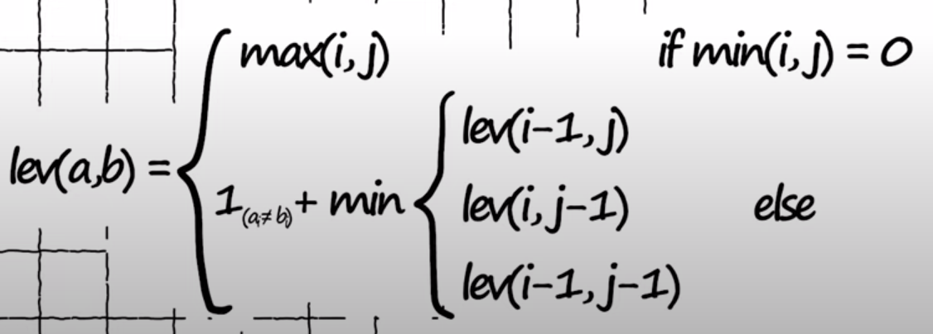
Levenshtein

Slide 5
Vector based Methods
TF-IDF
BM25
SBERT

Slide 6
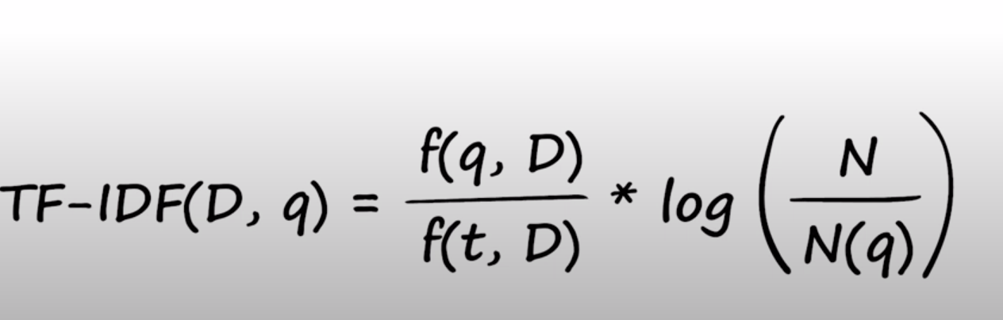
TF-IDF

Slide 7
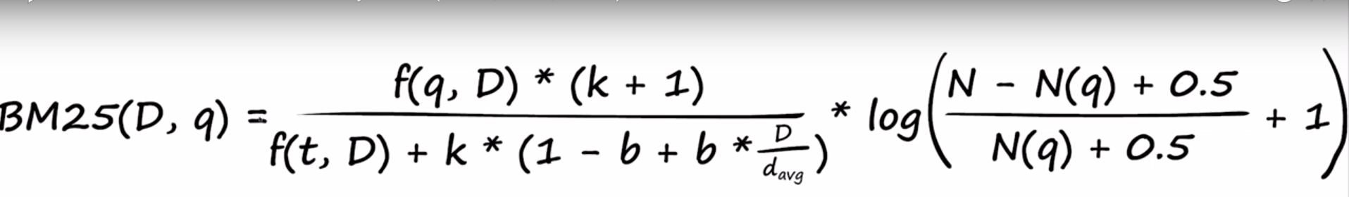
BM-25

Slide 8
SBERT
Generate dense vector for the queries
Find the cosine similarity

Slide 9
Index Types
Flat - Flat vector space with L2 distance
LSH - Locality sensitive hashing
HNSW - Hierarchical Navigable Small World
IVF - Inverted File
PQ - Product Quantization

Slide 10
Flat Indices
Flat indices are normal indices in vector space
Calculates L2 or IP distance between the vectors - IndexFlatL2 or IndexFlatIP
Normal speed but good accuracy

Slide 11
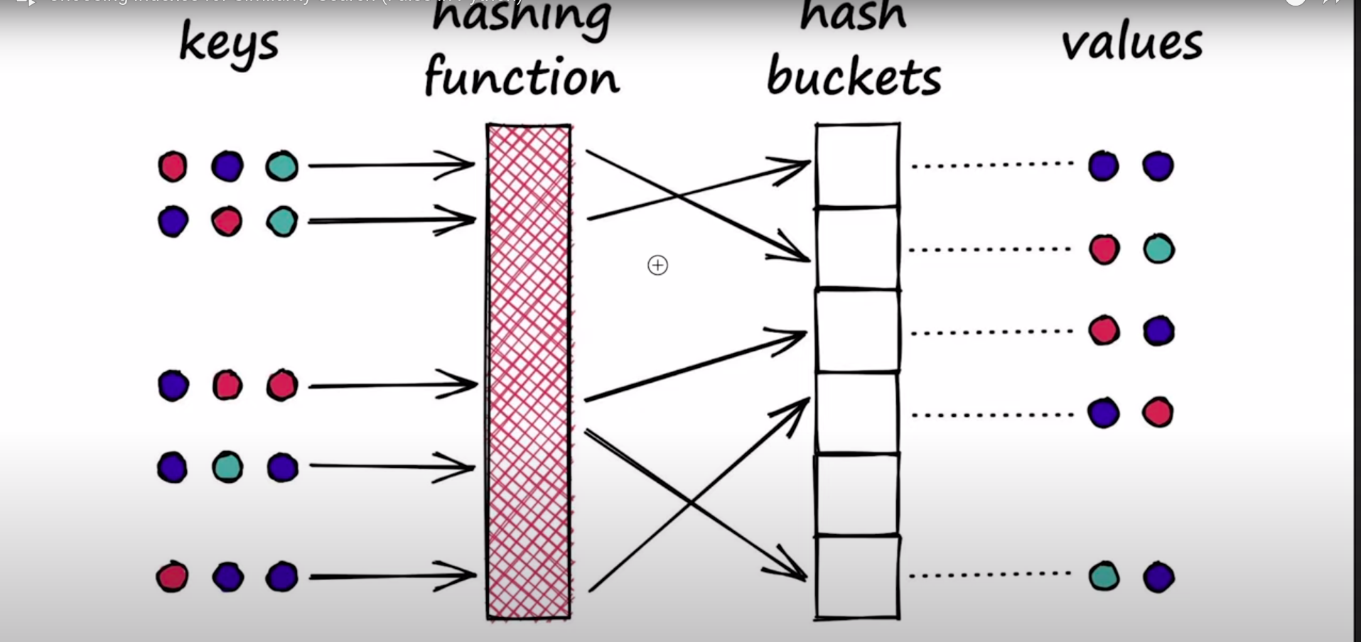
Locality Sensitive Hashing

Slide 12
LSH
Groups into buckets
Avoids collision
Finds the nearest buckets by hashing function
Represented as IndexLSH
Much faster than Flat but slightly less accurate

Slide 13
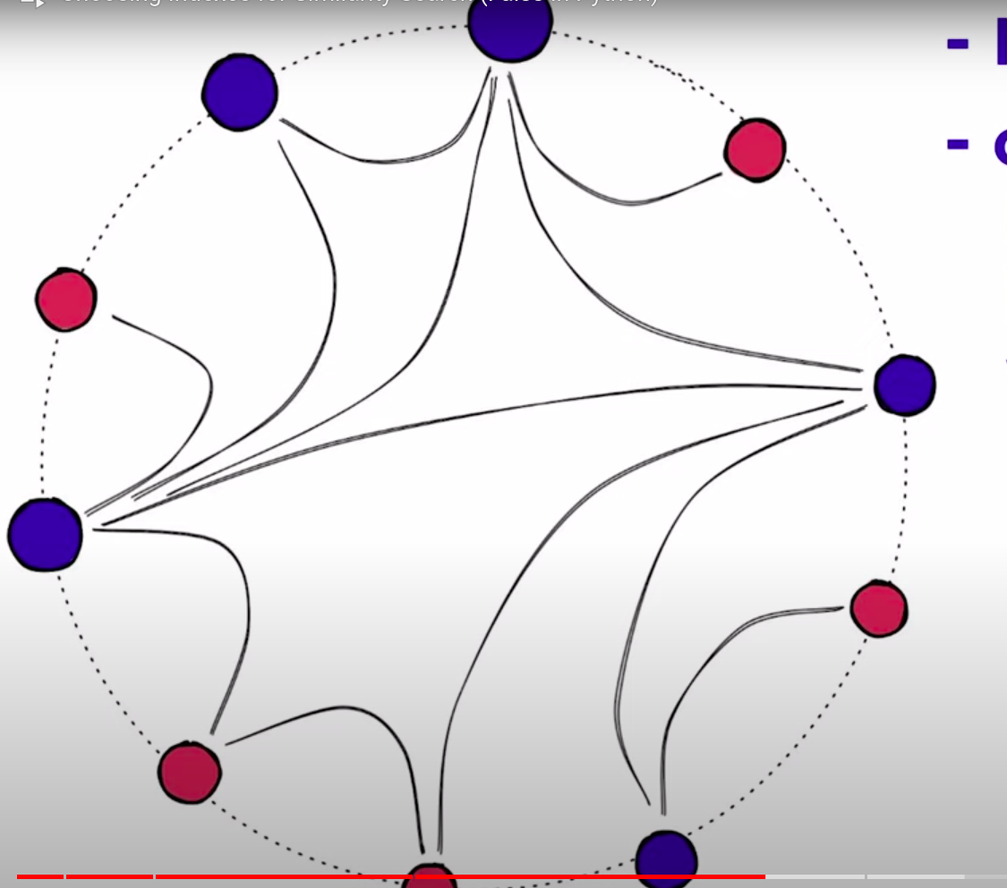
HNSW

Slide 14
HNSW
Graph based algorithm
Works based on the number of hops
To find the target, it hops through the vector and finds the target in an efficient way
Represented as IndexHNSW

Slide 15
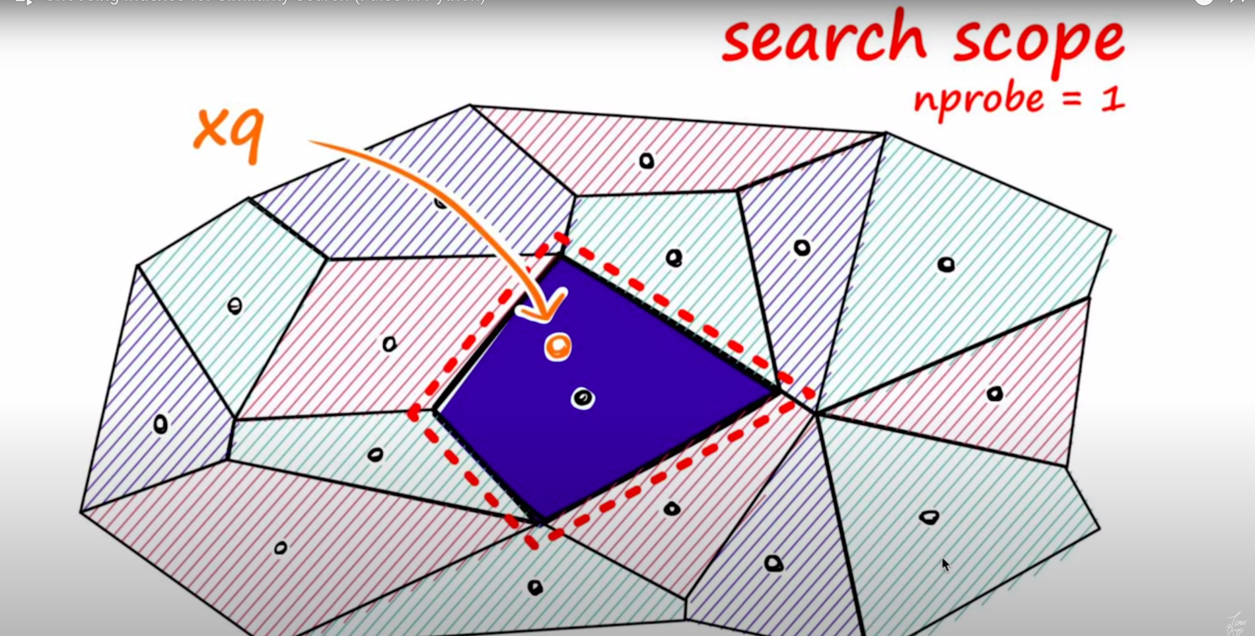
IVF

Slide 16
InVerted File Index
Much faster as it scans only the selected region based on the centroids
Edge problems - if the query vector is present in the edge of the centroid the error will be high

Slide 17
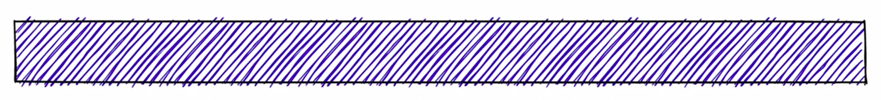
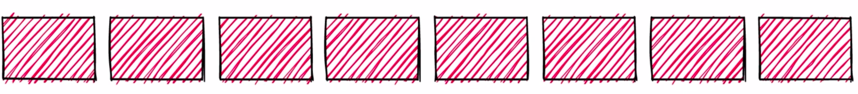
Product Quantization

Slide 18
